Slide 1
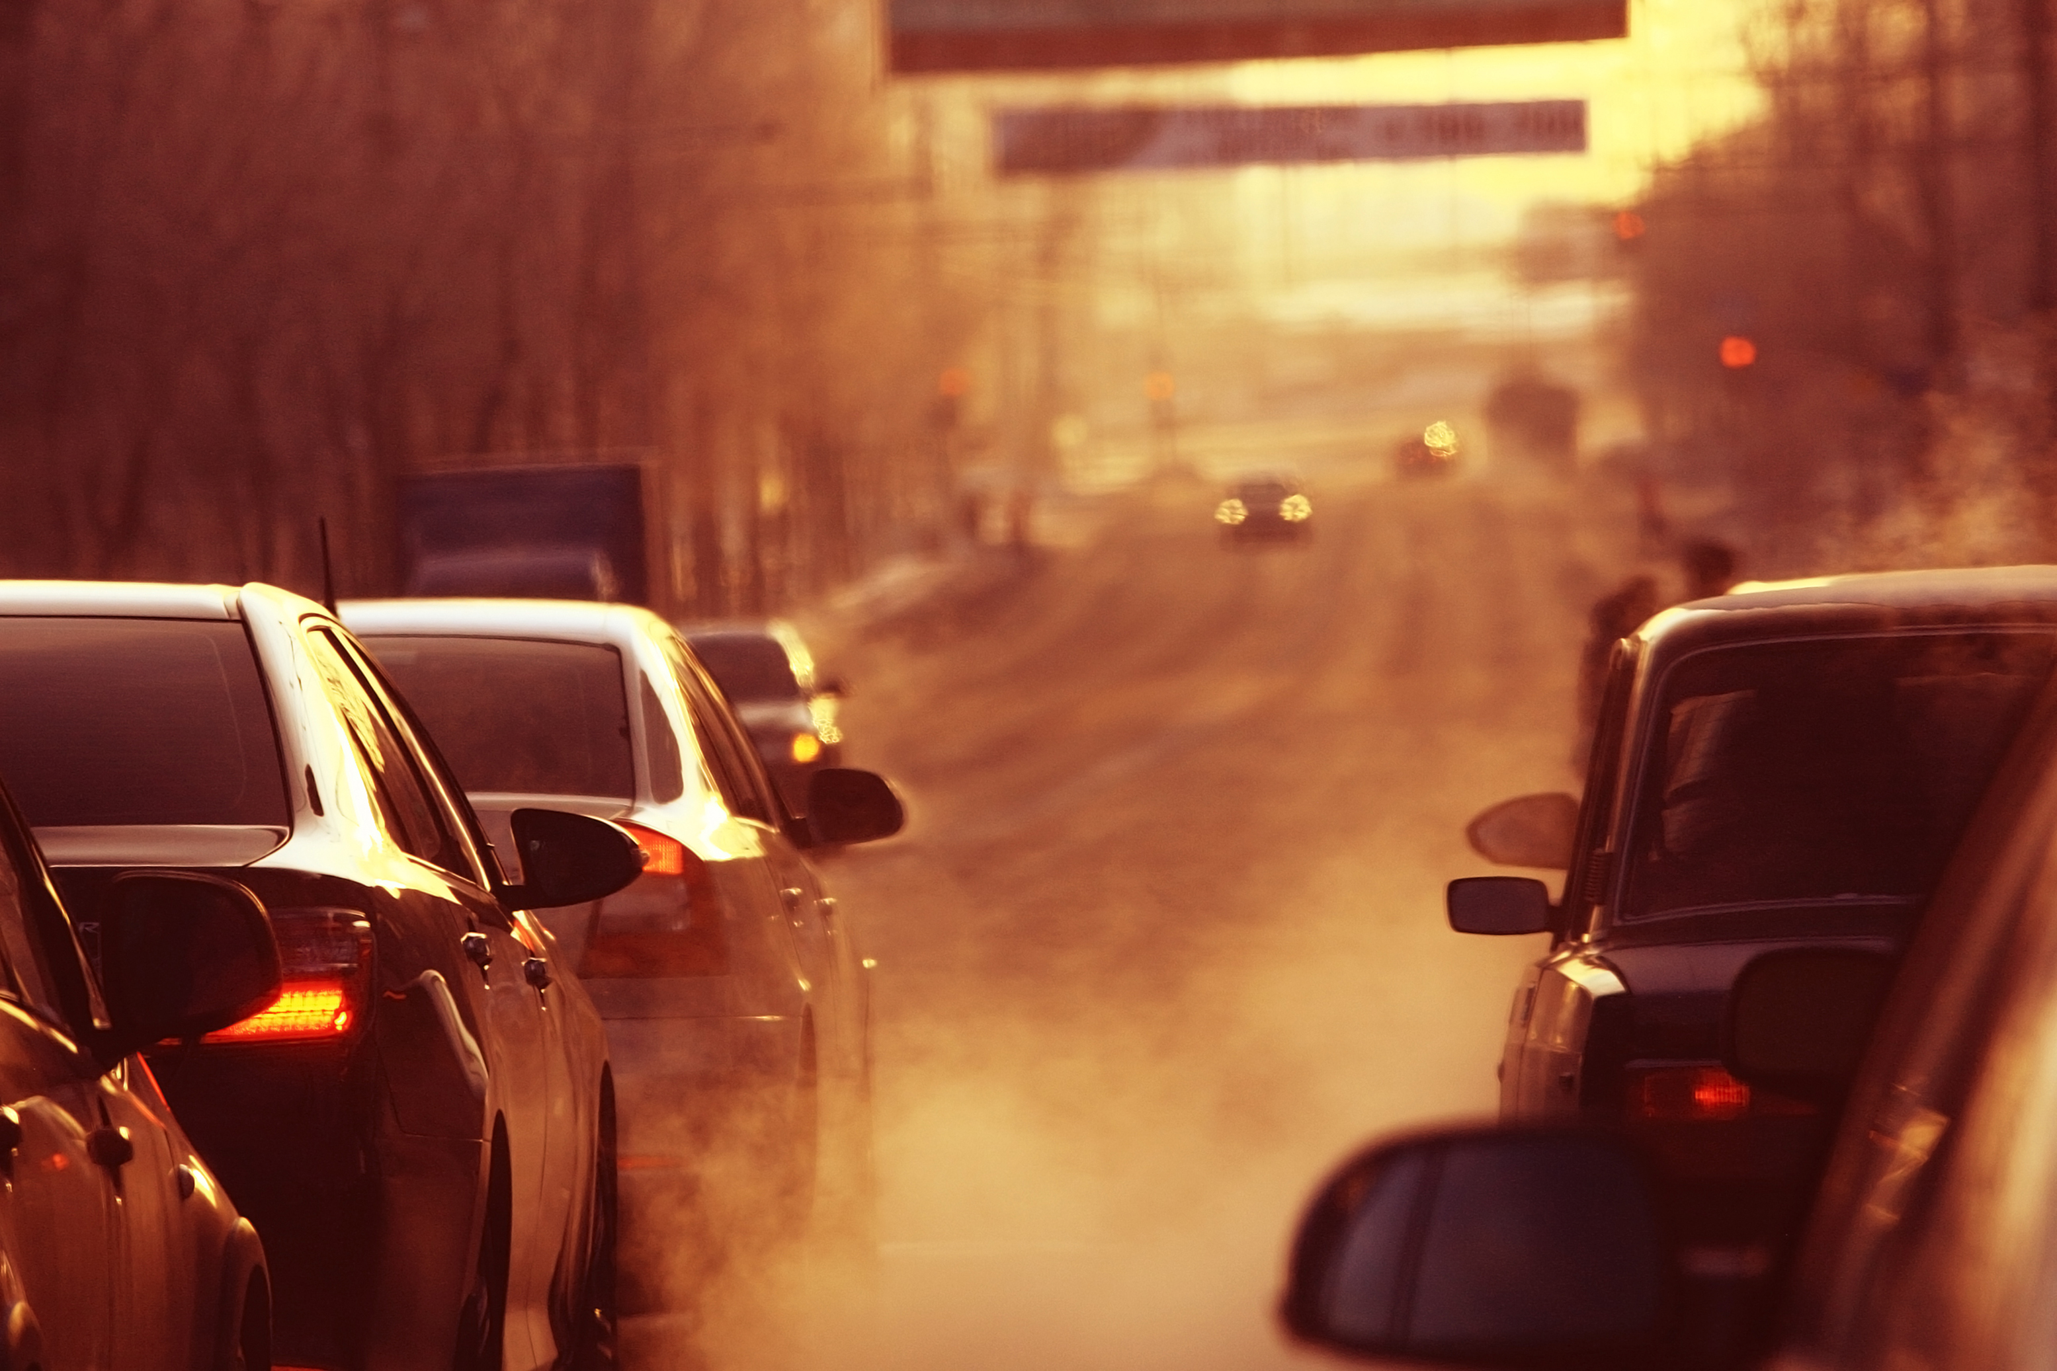





Vehicle CO2 Emission Tracker
L.D. COLLEGE OF ENGINEERING
Leader : Rushikesh Mujpara
Member : Rohan Chaudhari
Member : Mihir Jethava
Member : Priyank Badarshahi
MENTOR NAME : PRIYA SHAH

Slide 2
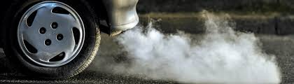
PROBLEM STATEMENT
Delayed Emission Detection
Dependence on Expensive Sensors
CO₂ emissions in urban areas are often identified late due to the absence of real-time automated monitoring systems. This delay reduces the effectiveness of timely corrective actions.
Traditional CO₂ monitoring systems rely on sensors, which are costly and difficult to install across large areas.
Lack of Real-Time Emission Analysis
Limited Scalability of Traditional Methods
Existing systems do not provide real-time CO₂ emission data, delaying environmental decision-making.
Traditional monitoring methods cannot be easily expanded to cover large urban or rural areas

Slide 3
SOLUTIONS
1
2
3
4
An AI-based system using MobileNetV2 analyzes traffic images to estimate CO₂ emissions automatically. This removes delays and enables faster identification of
pollution levels.
Uses image-based analysis, removing the need for expensive sensors.
MobileNetV2 processes images quickly and efficiently, enabling near real-time estimation of CO₂ emissions.
Works with CCTV images to cover large areas efficiently.
Automated Emission Detection
Sensor-Free Monitoring System
Real-Time Emission Analysis
Scalable AI-Based Monitoring

Slide 4
END USERS
Traffic Department
Environmental Agencies
They can identify high-traffic areas and manage vehicle flow to reduce emissions.
Organizations can track pollution levels and develop strategies for environmental protection.
END USERS
Traffic and environmental departments can use the system to monitor CO₂ emissions and take actions to control pollution.
Urban planners can analyze emission data to design better traffic systems and reduce pollution in cities.
Government Authorities
Smart City Planners

Slide 5
METHODOLOGY
1
2
3
4
5
6
Image Input
Image Preprocessing
Vehicle Classification using MobileNetV2
Assign Emission Factors
CO₂ Emission Calculation
Result Visualization

Slide 6
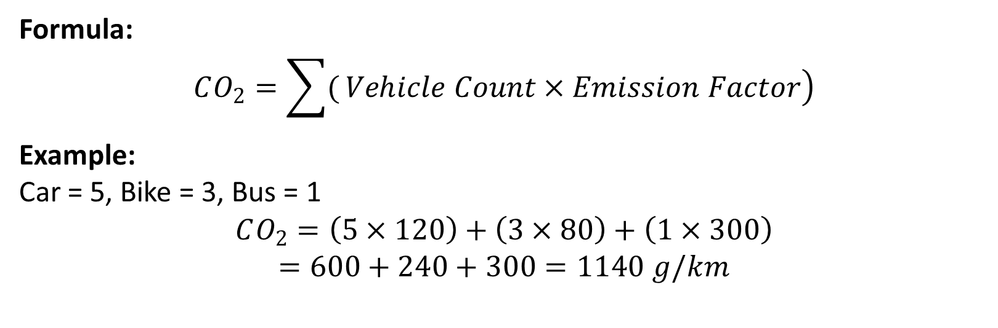
CO₂ Calculation
Formula:
$$CO_{2}=\sum{(}\left.Vehicle Count×Emission Factor\right)$$
Example: Car = 5, Bike = 3, Bus = 1
$$CO_{2}=\left(5×120\right)+\left(3×80\right)+\left(1×300\right)$$
$$=600+240+300=1140 g/km$$

Slide 7







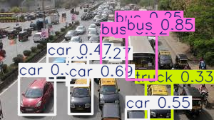

TECH STACK
DETAILS OF DATASET
COCO Dataset
Total Images: ~330,000 images
Labeled Images: ~200,000 images
Total Annotations: 1.5 million+ object instances
Number of Classes: 80 object categories
CO₂ Emission by Vehicles
Assumed Values
Car → 120 g/km
Bike → 80 g/km
Bus → 300 g/km
Truck → 400 g/km
-------------------------------------------------------------------------------------
Class -1 : bus
Class – 0 : car

Slide 8
WOW FACTORS
WOW
Estimates CO₂ emissions using only images—no expensive hardware required.
Uses MobileNetV2, making it fast and efficient even on low-power devices.
Quick image analysis enables near real-time emission estimation.
Eliminates the need for physical sensors, reducing overall system cost.
Can work with CCTV or traffic images across large areas.
Can be integrated with maps and dashboards for visualization.
FACTORS

Slide 9
THANK YOU

